Slide 1

Electronic Healthcare

Slide 2
Motivation behind the idea
Make Hospital procedures:
More easily
In less time

Slide 3
Problem statement
With the development of technology there are some hospitals use paper to print requirements like vitamin D or x-ray etc for the patients
With so many requirements, the process became boring and slow

Slide 4
Introducing of idea
To create a website, this site makes it easy for the patient to see the result of vitamin D analysis or to see the results of x-rays

Slide 5
Why did I used Blockchain for it?
Reduce costs of all transactions
Improved security
Increased speed of transactions
No central authority

Slide 6
Main functionalities of the dApp
The patient can communication with doctor at home
The patient can watch all results and reports at home
The patient can book appointments at home

Slide 7
Main functionalities of the dApp
Doctors can give requirement for some patient
Hospital Managers view doctors reports (weekly, monthly )

Slide 8
The Entities involved
Hospitals
Patients
Doctors
Hospital Managers
Ministry of Health

Slide 9
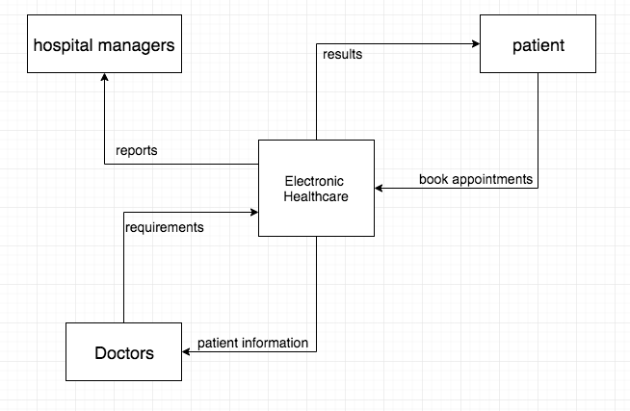
Context Diagram

Slide 10
Any Questions?

Slide 11
Thank You

